Slide 1



Sync 3.2 Controlled vocabularies and ontologies
UHC Summer Institute - June 29
Ran Li, Ms
Ana Ortigoza, MD PhD

Slide 2
Roadmap
Intro - Big Picture
Define FAIR meta(data)
Define FAIR meta(data)
Collect FAIR meta(data)
Utilize FAIR meta(data) + wrapping it all up in a DMP

Slide 3
Overview
Recap
Wrap up Ontologies
Sharing ontology
Unique identifiers: Things not strings (orcid)
Public Health Ontology
Meta(data) collection
Introduction to CEDAR
Create intake form for public health ontology

Slide 4
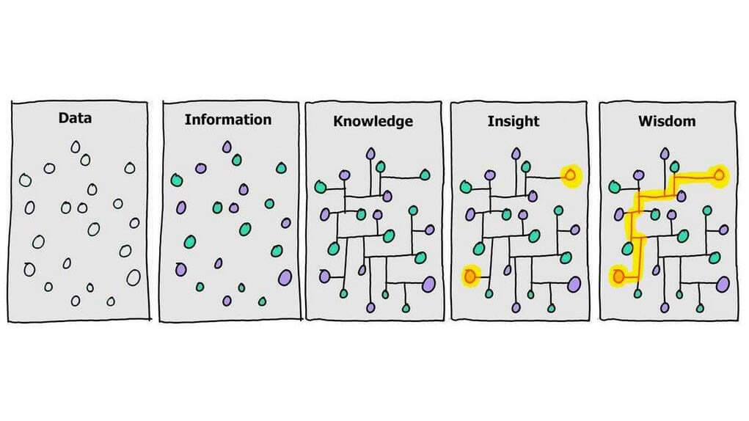
Recap
Ontology (Concepts, Relationships)
Metadata (.RDF)
Notes:
RECAP day 2/3. The value of adding metadata to your data.

Slide 5
Sharing Ontology
Version control of
Deploy Netflix to Bioportal
Review Bioportal entree + mappings
Unique identifiers

Slide 6
CEDAR: Intro
CEDAR is a technology to use metadata standards
Notes:
- https://www.youtube.com/watch?v=ODh7j1H2zcQ&ab_channel=ISCB

Slide 7
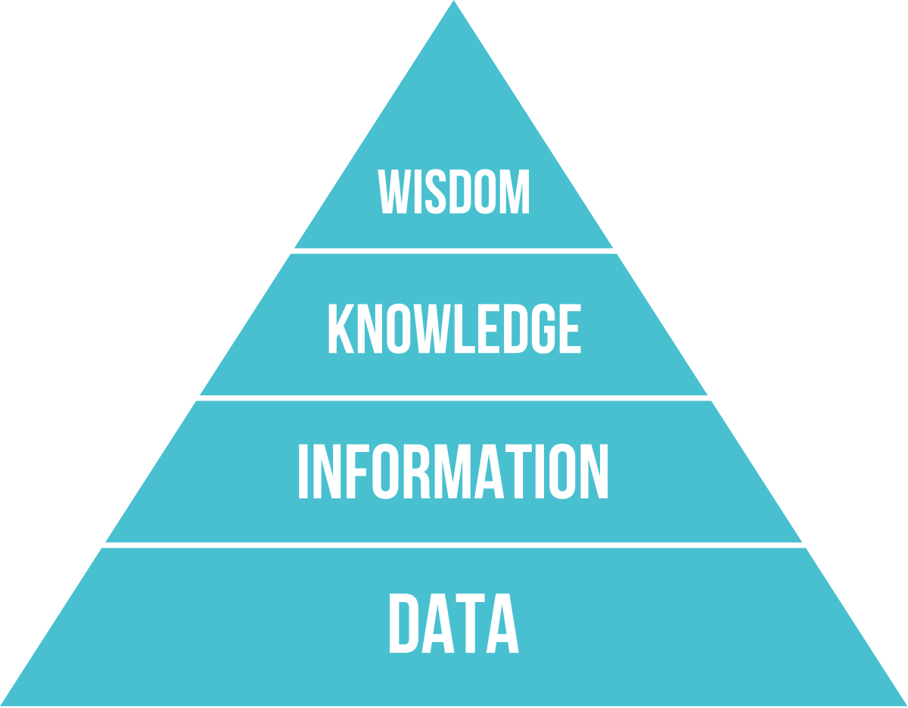
FAIR in the context of data
DIKW Pyramid: A model that transforms raw data into insightful wisdom.
Levels:
Data: Unprocessed, raw facts.
Information: Structured and meaningful data.
Knowledge: Understood and applied information.
Wisdom: Principles guiding decisions, derived from knowledge.
FAIR principles are a roadmap to transforming you data to valuable insight in manner that utilizes machines.
Notes:
(Slide introduction) "Today, let’s introduce this model of data that will give us context for why defining FAIR metadata is important.."
(Point 1) "The DIKW Pyramid, standing for Data, Information, Knowledge, and Wisdom, illustrates the transformation of raw, unprocessed data into actionable wisdom."
(Point 2) "At the base of our DIKW pyramid, we have Data, which represents raw, unstructured facts. This Data is processed and organized into Information, adding meaning and context. This Information, when understood and applied, becomes Knowledge, allowing us to recognize patterns, relationships, and principles. At the top of the pyramid, we have Wisdom, where we distill our knowledge into guiding principles that facilitate informed decision-
FAIR principles are a roadmap to transforming you data to valuable insight in manner that utilizes machines. Lets start with one key concept introduced yesturday: RDF format for capturing metadata.

Slide 8
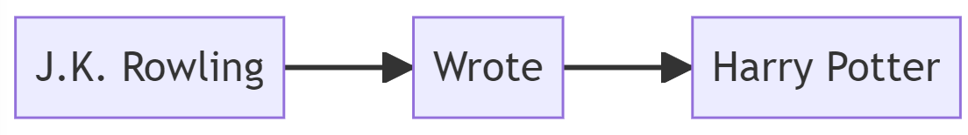
RDF
RDF = research description framework
Simple triple based data model
Subject - predicate - object
Enables graph-based formalism for representing metadata
Notes:
RDF is the research description framework. When we are talking with someone we are making sentences. we are talking about a subject predicate an object. its like a normal sentence. RDF allows us to define data Ina similar way that is understandable by the machine. For example. Lets talk about JK Rowlins is the author of the book Harry Potter. So if I want this understandable by the machine, i can present it prsent very simple with these three things. THe subject is J.K. Rowling, the predicate 'is author of', hte object is 'harry potter'. Everything in terms of data is given a unique identifiers, whether is a object or the thing that represents the relationship between objects.
RDF can be used to capture informatino about any domain. For example in the domain or context of this course. Ran is an isntructor, Ana is an instructor, each of you are students.RDF is heart of linked opendata. So the idea hta teveryone would publish their data in the web and people can start linking it. So a lot of effort start in many different industry to build up a linked data that is published. For example Wikipedia is is knowledge base built on RDF.

Slide 9
From data to Information: RDF
Data: Raw, unprocessed, context-less facts.
Information: Context-enriched, structured data.
RDF's Role: RDF enriches data with metadata, facilitating its transformation into Information.
Notes:
(Slide introduction) "The transformation from Data to Information in the DIKW Pyramid is critical. Let's examine this process and the role of the Resource Description Framework, or RDF."
(Point 1) "At the base of the pyramid is 'Data'. This represents raw, unprocessed facts and figures, often unstructured and without context or interpretation."
(Point 2) "Moving up the pyramid, we arrive at 'Information'. This is where raw data has been processed, structured, and given context. It's data that is meaningful and useful."
(Point 3) "RDF plays a pivotal role in this transformation. As a standard model for data interchange, RDF allows us to enrich raw data with additional information, or metadata, making it machine-readable. This enrichment adds structure and context to the data, effectively transitioning it from raw Data to useful Information. So, RDF is a tool that facilitates the transformation from Data to Information, aiding in making sense of and adding value to our raw data.“
Lets now move on to the concept we introduced yesturday which was Onotlogies and how this helps us move up the data value pyramid.

Slide 10
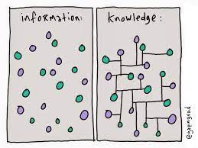
Ontology
A knowledge model which defines a set of concepts and relationship between those concepts within a domain
Why define controlled vocabulary?
Why define relationships?
Notes:
Ontology is extracts the knowledge in your head and model it in a way that is understandable by a computer so i can automate the things you do as a person by the computer. So what does Ontology mean. Ontology is actually something allows you to define the concepts in a domain and the relationships between them.
Why define concepts? Why is it useful and why we need it.
One example is when working with banks. One says client one says customer. Sometimes its the same but sometimes it is not. one may think only someone with an account is a customer, others will think anyone that walks into my bank and does any type of transaction (e.g. cashing a check) is a customer. its a completely different definition to the same word being use. Therefore, its really important when your working in a domain with different teams to actually understand what are the concepts that we are using and what do they mean by these concepts. So we can start interoperating with each other and then you can integrate the information together. This applies well to big research organizations that have many teams and domains.
Why define relationships:
Relationships give context to individual pieces as shown in the graph to the right. Starting with the pyrmid base we have data on the bottom. THe enxt step is enriching your data with context and histroy and we talk about information. THe next step built ontop of information is when your talking about knowledge. If you think about it what ever decision e are making these days... whatever intelligent stuff that we are doing is only because we have knowledge about things; we know what things mean in certain context and we know how to link together and use them to answer specific questions or make decision. So if we really want the computer to do that same thing the most important step for us is to actually give that knowledge to that computer. so it would be machine processable so they could actually autoamte and replicate what we do as humans to make decisions;
Simple meaning of ontology: extract the knowledge in your head and model it in a way that is understandable by a computer so we can automate the things you do as a person by the computer
Next we will introduce the defacto standard for building ontologies the OWL model.

Slide 11
Ontology with OWL
RDF based
Defactor standard for ontology development
Main components include
Classes: define concepts within a domain
Properties: define relationships
Object properties: class <-> class
Datatype property: class -> literal
Restrictions: rules about relationships that (e.g. A movie cannot be a tv show)
Notes:
Based on RDF

Slide 12
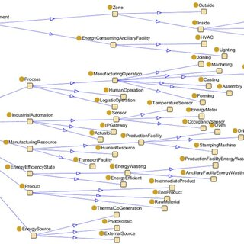
FAIR Infrastructure
RDF + Ontology = FAIR meta(data) system
Manual handling is error prone and doesn’t scale
FAIR system will utilize machines to scale as your volume and complexity scales.
Notes:
When you put information (data in RDF format) and context (ontology) you get a `smart data` system. The computer can understand your data and act over it within the context of the ontology (concepts, relationships, rules) you define. It can validate new data, infer new knowledge (e.g. check if something isn't right).
Why? FAIR infrastructure scales with volume and complexity.
Lets say you have a project that is just 2 people and lets say 5 different data sources . You can get away with not utilizing a 'smart data' system and handle all the (data, context, restrictions) manually.
Two brains can roughly handle the amount of memory/computation needed... but data and metadata there are so many anomalies and rules you have to keep in mind. So obviously this is not just error-prone if done manually but also does not scale.
Say the project scales to 50 people and 5000 data sources handling this manually just with people is not feasible. You have to then train people to interpret data, keep on the same page in terms of definitions, rules, restrictions, anomalies then ask them to infer context then generate new knowledge on a mountain of data. This is very difficult... if not impossible.
However.. a FAIR system with data enriched metadata in (RDF format) and context (via OWL ontology) captures all the concepts, relationships and rules in a way that is understandable by a computer so we can automate the things we do as a person by the computer. So utilize a FAIR system, you could handle much more volume and complexity with much fewer people. So understanding at the core of FAIR is understanding some tasks are for machines. and we need to learn the tools to start conceptualizing our work in a way that is machine actionable or a way the machine can understand and thus automate and generate knowledge.

Slide 13
FAIR in the context of data
Levels:
Data: Unprocessed, raw facts.
(RDF) Information: Structured and meaningful data.
(Ontology) Knowledge: Understood and applied information.
Notes:
Think of the FAIR implementation journey. We start with Data, which is just raw, unorganized facts. Using tools like RDF, we give this data a makeover, adding context and structure and turning it into useful Information that machines can understand. But we don't stop there. We then use ontologies, which introduce controlled vocabularies and relationships , to sort and connect this information, which helps us create Knowledge.
So this is foundation from which we build FAIR infrastructure.
In the context of Data Science and AI. The models we build rely on data with rich metadata. No matter how good your project’s statistics, data science, web development. Its all built on data and metadata. You cannot generate deliverables or insight without FAIR data systems.

Slide 14
NetFlix ontology Recap
Go through the group chat and build out the ontology
Focusing on two specific issues:
How to define ‘Fantasy’ : a class, individual or data?
How to define ‘English’ as a class or individual?
Deploy our Ontology to a repository
Notes:
Difficult to formalize what are very connections between concepts that are by nature intuitive to humans
But This is one of the challenges but most important aspects of

Slide 15
Public Health ontology brain storm
Classes:
Represent concepts in a controlled vocabulary.
???
Individuals:
Represent instances of these concepts.
???
Relationships:
Represent instances of these concepts.
???
Notes:
Overall goal is to expose domain-experts to the tools to start learning, building and sharing ontologies. These tools include:
Bioportal (Repository for ontologies)
BioPortal is a powerful and widely utilized online platform for accessing and exploring biomedical ontologies and terminologies. Developed in Stanford and funded by both the NIH and NSF; this is the main repository for research currently. Started out as a biomedical ontology and that is its focus. Other domains such as public health don’t really have a robust ontology repository specific to this domain so for now most people just use bioportal
Protégé (Software for working with ontologies)
Protege is a popular open source software tool for working with ontologies, developed by the Stanford Center for Biomedical Informatics Research in collaboration with the Stanford University School of Medicine. The project has received funding and support from various organizations, including the National Institutes of Health (NIH), the National Science Foundation (NSF), and the European Union. It contu

Slide 16
Roadmap
Intro - Big Picture - 6/26
Define FAIR meta(data) – 6/27
Define FAIR meta(data) – 6/28
Collect/Utilize FAIR meta(data) – 6/29
Putting it all together in a DMS/DMP – 6/30

Slide 17
Thanks!

